Slide 1
Insert USF EEP Logo
(branding)
Branding of Master Slide
Stability Operations:
Afghanistan
Adib Farhadi, Ph.D.
University of South Florida

Slide 2
Welcome
Please introduce yourself . . .
. . . Share at your table the most recent negotiations you were involved.
Identify the top three things for your table that you would like to learn during our next two days?
What knowledge or ability that you could learn today that will delight you?
Notes:
Get the participants to feel comfortable and start talking immediately in their table. If the class is big then just tell them to introduce themselves in the table if the class is small then have everyone introduce themselves.
Start managing expectations early
Write Down the top 3 things they want to learn in the flip chart
Write Down what would delight them
Start explaining the Learning Outcomes of the course leading to the Agenda Slides

Slide 3
Agenda
Day 1: Understanding Stability Operation in Afghanistan
What is Stability Operations and CT within the context of Afghanistan?
Why is it difficult?
What is the state of economy?
Who are the major players?
What is the USG policy in Afghanistan?
What are threats, challenges and opportunites?

Slide 4
Agenda
Day 2: Applying Stability Operations in Afghanistan
The role of PRT’s in Stability Operations
The role of Village Stability Operations
Regional Cooperation Strategy
What do we learn from the Case Studies?
Lessons Learned Excersise
How do we apply and practice

Slide 5
Your expectations and my goals
What would you like to bring with you from this program?
Stability Operations cannot be covered in two days.
Yet, I hope you gain an in-depth hands-on policy-oriented practitioner’s experience to acquire a better understanding of this important topic
Gain experience in the practice and application process of Stability Operations to advance your career or personal goals.
My expectation: That you come forward with your questions and input
Notes:
Learning environment and format:
Lecture and workshop
Learning by doing – examples and experiences
Active participation and reflection as learning method
’Rules for growing and learning’
Participate - be active and share – and it’s OK to ’fold’ (observe)
A confident room and a punishment free zone
We are different – and it is....

Slide 6
Learning Objectives
Describe Afghanistan’s current economy
Describe the role of economic development in a COIN strategy
Explain inhibitors and enablers to Afghanistan’s trade and economy
Describe the status of the health and education sectors
State the challenges for the health and education sectors

Slide 7
Learning Objectives
Describe Afghanistan’s current economy
Describe the role of economic development in a COIN strategy
Explain inhibitors and enablers to Afghanistan’s trade and economy

Slide 8
Learning Objectives
Describe Afghanistan’s current economy
Describe the role of economic development in a Stability Operations
Explain inhibitors and enablers to Afghanistan’s trade and economy

Slide 9
Learning Objectives
Describe Afghanistan’s current economy
Describe the role of economic development in a COIN strategy
Explain inhibitors and enablers to Afghanistan’s trade and economy

Slide 10
Learning Objectives
Describe Afghanistan’s current economy
Describe the role of economic development in a COIN strategy
Explain inhibitors and enablers to Afghanistan’s trade and economy
Describe the regional economic landscape

Slide 11

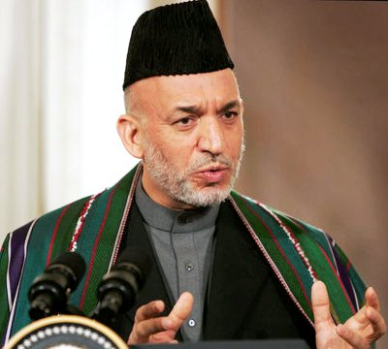
“Defeat of the Taliban”
“In Afghanistan we defeated the Taliban regime,”
President George Bush, July 4, 2002
“In the battle of Afghanistan, nations from central and eastern Europe supplied soldiers and special forces and peacekeepers to help defeat the Taliban, to help destroy the terrorists and to bring freedom to the Afghan people.”
President George Bush, May 2003
“And as a result of the United States military, Taliban no longer is in existence. And the people of Afghanistan are now free.”
President George Bush, September 2004
"I don't see a resurgence of the Taliban. As far as the defeat of the Taliban is concerned, they are defeated, they are gone-as a movement, as a government, as a structure, a political structure, a religious structure-they are not there.“
President Hamid Karzai June 8, 2003 BBC
“The Taliban are defeated and not coming back, our priority now is narcotics and rebuilding of Afghanistan,”
President Hamid Karzai, February 2005

Slide 12
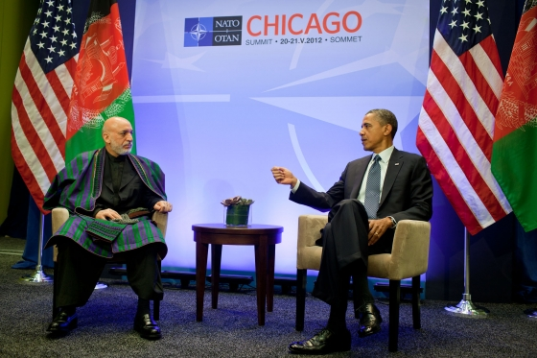
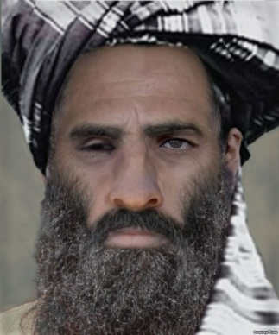
“Making Peace with the Taliban”
“In coordination with the Afghan government, my administration has been in direct discussions with the Taliban. We have made it clear that they can be a part of this future if they break with al Qaeda, renounce violence and abide by Afghan laws.”
President Barak Obama, May 3, 2012
"Even if the Taliban say they have killed my brother, I call on them, brothers, come make peace,“
President Hamid Karzai July 13, 2011
“You Have the Watches, We Have the Time”
Mohammad Mullah Omar March 2009

Slide 13
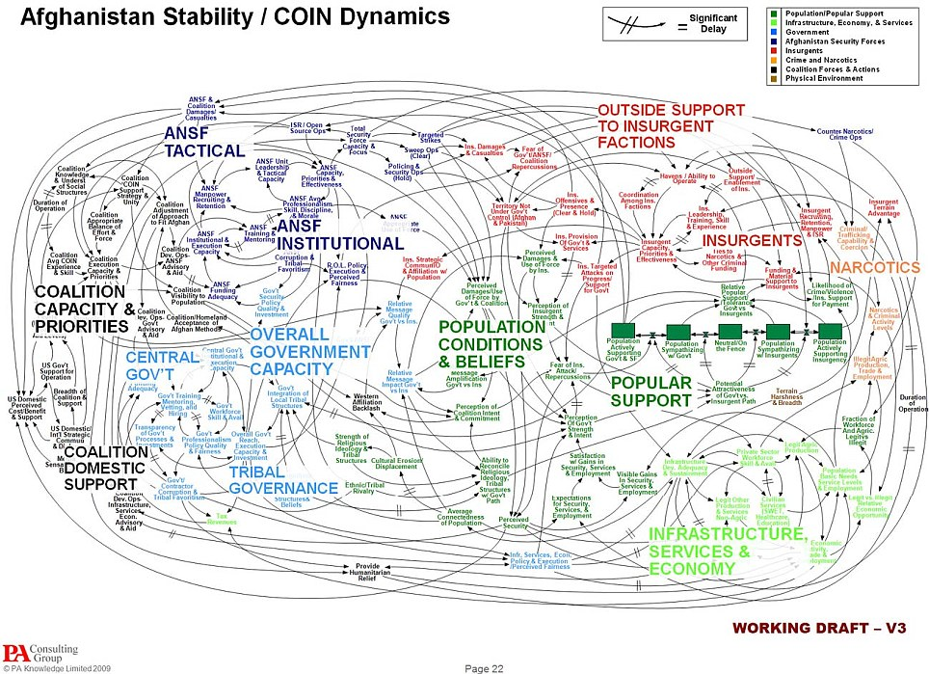
'When we understand that slide, we'll have won the war‘
General Stanley McChrystal

Slide 14
Economic Development: Why do it?
UNCLASSIFIED
Short Term
Reduce the economic incentive to join the insurgency
Raise revenue to pay for security and governance
Enable successful COIN strategies
Long Term
Establish an economy that isn’t dependent on the international community
Give Afghans a stake in the future of their own country

Slide 15
“One of the most important lessons of the wars in Iraq and Afghanistan is that military success is not sufficient to win: Economic development, institution-building and the rule of law, promoting internal reconciliation good governance, providing basic services to the people, training and equipping indigenous military and police forces, strategic communications, and more--these, along with security, are essential ingredients for long-term success …”
Defense Secretary Robert Gates November 2007
“COIN integrates military and civilian counterinsurgency activities, and is based on the theory that military operations alone are not enough to defeat an insurgency. The process of COIN has three objectives: first, the enemy must be cleared from the target area; second, the enemy must be kept out; and third, economic development and governance must empower the civilians of the region.”
General David Petraeus August 2010
“We believe there is not a purely military solution; we never believed it. However, military means are necessary although they are not sufficient”
General Stanley McChrystal December 2009
“U.S. understands that success in Afghanistan requires more than just a military solution. The military solution will not work alone, in order to defeat the insurgency a political, regional and economic solutions are also required.”
General John Allen March 2011
“Afghanistan requires a holistic approach …. a military solution alone cannot defeat the insurgency a regional comprehensive solution is required”
Supreme Allied Comdr. Admiral Jim Stavridis February 2011
Notes:
Nearly every observer of Afghanistan, from the most senior U.S. military officers to Washington think tank analysts and everyone in between, agrees that stability in that country demands a multi-pronged approach involving the military, diplomatic efforts and economic assistance.

Slide 16
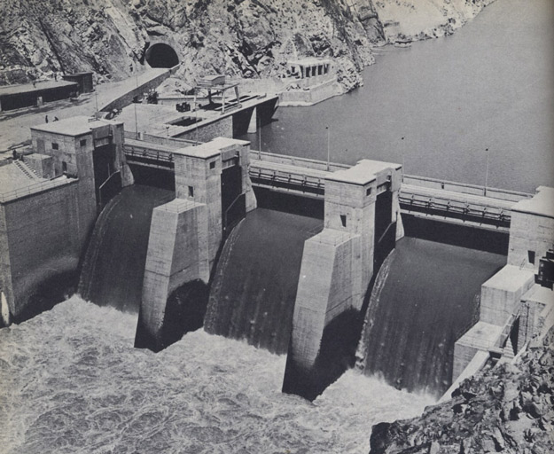
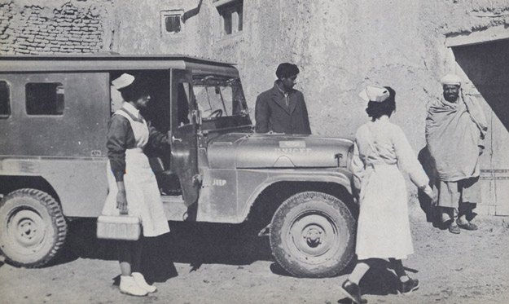
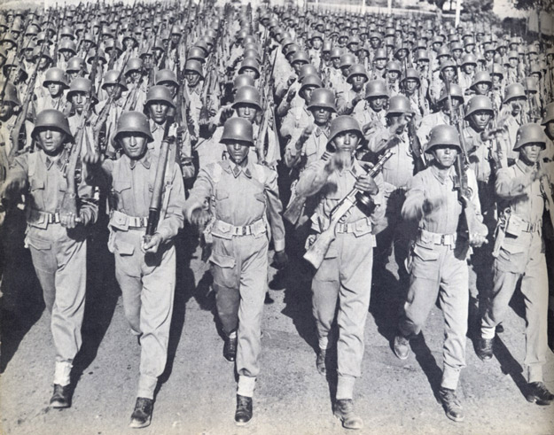
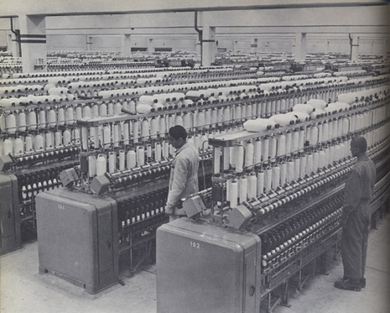
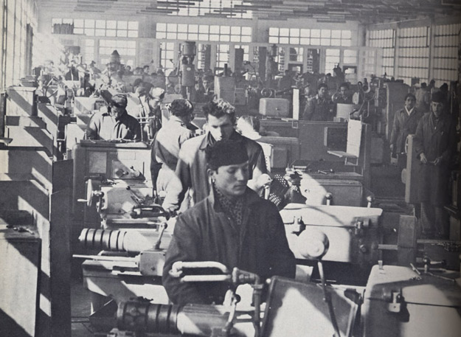
Once Upon a Time in Afghanistan
UNCLASSIFIED
Notes:
16

Slide 17
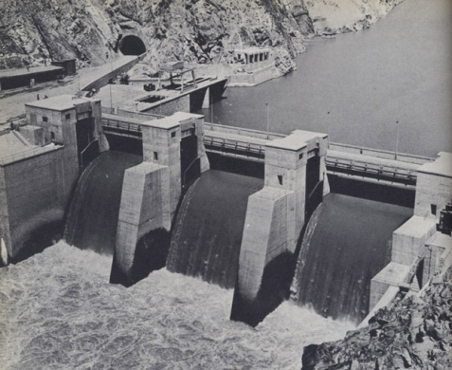


Afghanistan: Pre-Conflict Nation
UNCLASSIFIED
Functional economy until Soviet invasion
Mainly agricultural based
Leading exporter of dried fruits and nuts
Pomegranates and raisins prized
Light and Medium Industry
Large infrastructure projects
Notes:
17

Slide 18
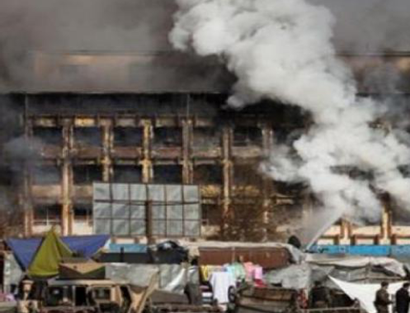
Afghanistan: A Post-Conflict Nation
UNCLASSIFIED
Government mismanagement and corruption
Loss of skilled manpower
Weak infrastructure
Lack of security
Reliance on foreign aid
Poor trading relationships
Wide-spread poverty
Dysfunctional economic systems
18
Notes:
18

Slide 19
What is Economic Development?
UNCLASSIFIED
World Bank Definition
Qualitative change and restructuring in a country’s economy in connection with technological and social progress
Main indicators: gross national product (GNP)/ gross domestic product (GDP)
19
Notes:
19

Slide 20
Military Transition
Governance Transition
Economic
Transition

Slide 21
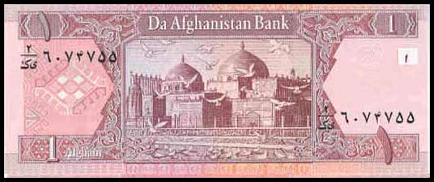
The Economy – The Bad News
Unclassified
Unemployment rate: 35% (2008 estimate); ranked 183 of 228 countries
Inflation rate: 13.3% (2009 estimate); ranked 214 of 228 countries
Population below poverty line: 36% (FY 08/09)

Slide 22
The Economy – The Good News
Unclassified
GDP $29.81 billion (2010 estimate); ranked 109 of 228 countries
GDP growth 8.9% (2010 estimate)
GDP per capita $1000 (2010 estimate)
Ease of Doing Business Index: 167 of 183 countries
Significant mineral resources
A rich heritage of textile production

Slide 23
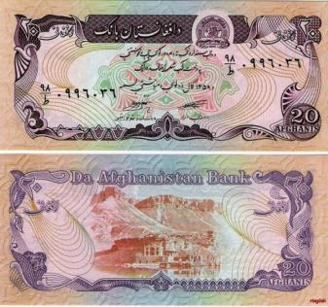
The Economy – Following the Money
Unclassified
Afghanistan Reconstruction Trust Fund (ARTF)
Da Afghanistan Bank
Weak Afghani currency
Hawala System

Slide 24
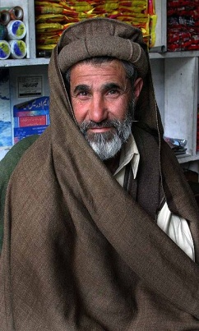
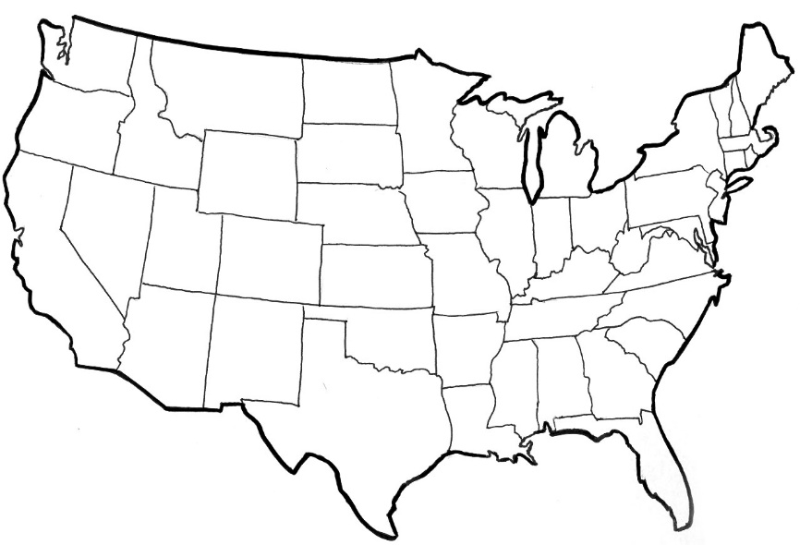

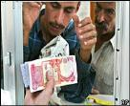

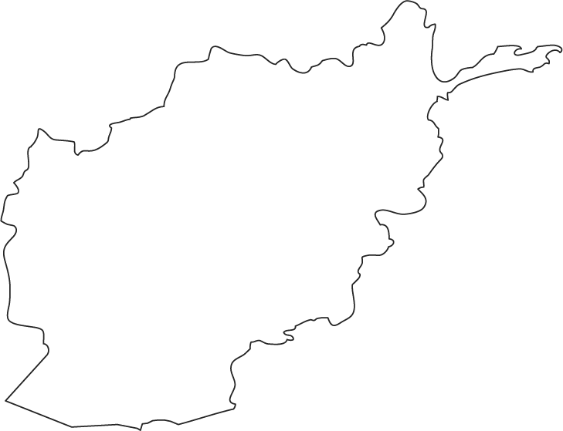
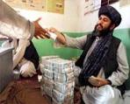

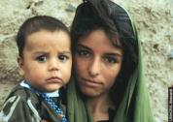
Hawala Operation
Unclassified
ID#
Owed Value
ID#
ID#
ID#

Slide 25









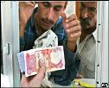










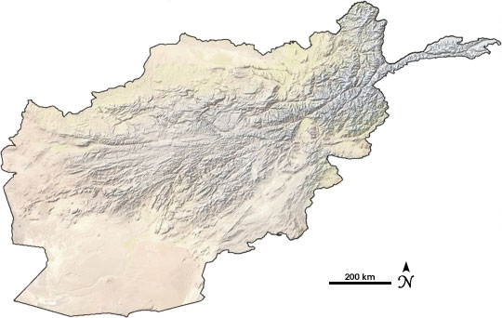


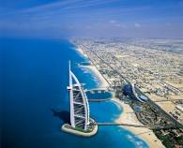


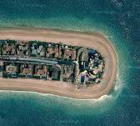

IVTS Operator Settlement
Goods
4
3
1
Illegal Goods
2
5
6
Deed
Illegal Goods
Notes:
25

Slide 26
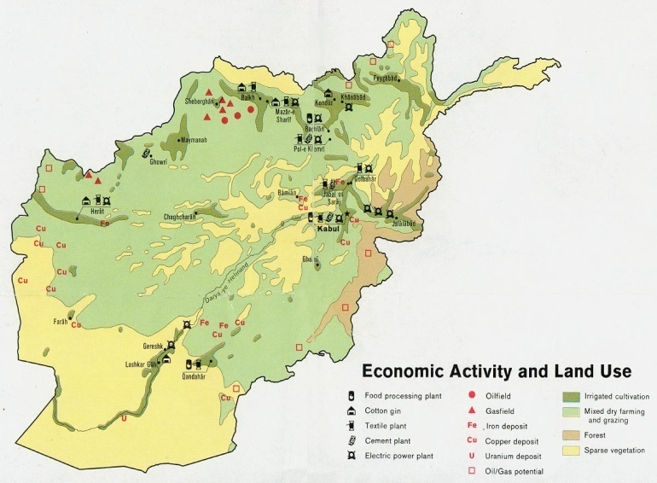
Labor Force and GDP Distribution
UNCLASSIFIED
Labor Force
Agricultural 78.6%
Industry 5.7%
Services 15.7%
GDP by Sector
Agricultural 31%
Industry 26%
Services 43%
Notes:
26

Slide 27
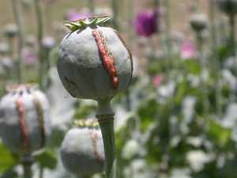
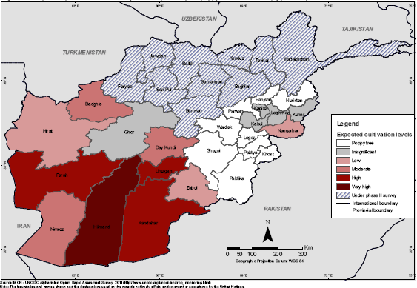
The Illicit Economy – Opium
Unclassified
Afghanistan produces 90% of the world’s opium
Opium economy equals one-third of the licit economy
One million Afghans are addicted to drugs – 8% of the population between 15 and 64

Slide 28
Bittersweet Harvest
UNCLASSIFIED
28
Notes:
28

Slide 29
Consequences of Opium Cultivation
Unclassified
Increase in drug addiction and HIV in Afghanistan and its neighboring countries
Increase in corruption at all government levels
Decreases GIRoA’s ability to enforce the rule of law
Finances the insurgency and warlords
Afghanistan’s largest export – opium – isn’t taxed and tariffs aren’t being collected

Slide 30
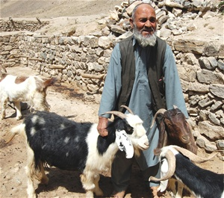
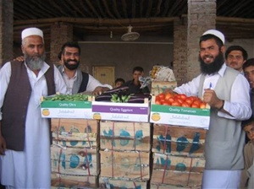
Alternative Programs
Unclassified
USAID
High value fruit/nut production
Livestock management
Packaging/storage/marketing
European Union
Agriculture training
Fish farming
Agricultural Cooperative Development International
Fruit nurseries
Training for para-vets

Slide 31

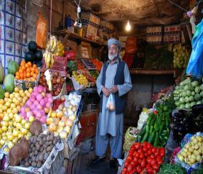
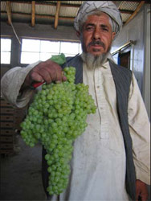
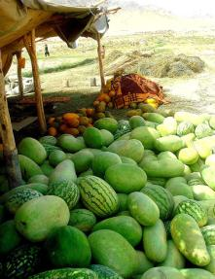
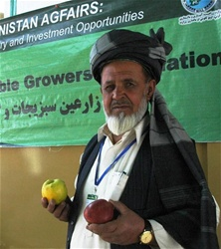
Major Agricultural Products
UNCLASSIFIED
Notes:
31

Slide 32
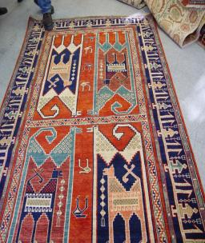
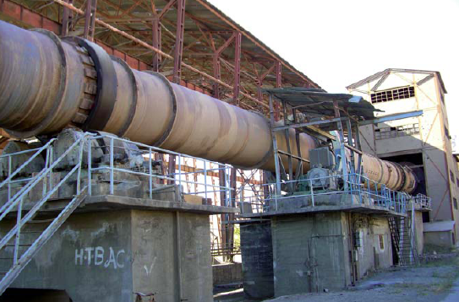
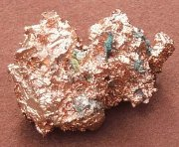

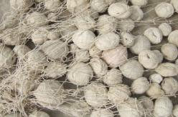
Major Non-Agricultural Products
UNCLASSIFIED
Notes:
32

Slide 33
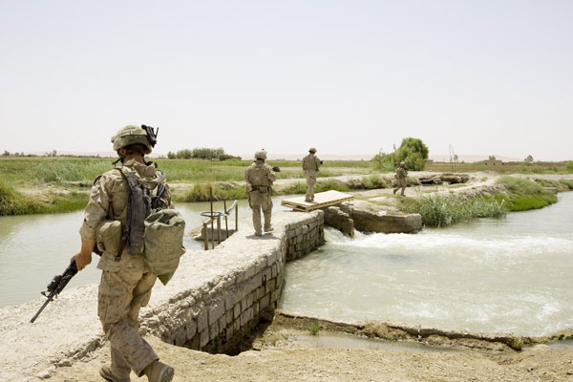
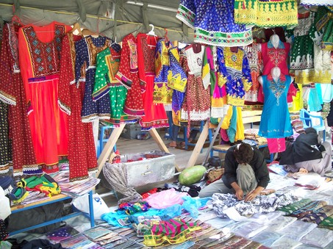
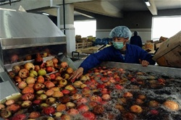
Economic Development, Infrastructure and COIN
UNCLASSIFIED
Local Development Emphasis
Water and Irrigation
Local Road Systems
Fruit Processing
Bazaars
33
Notes:
33

Slide 34
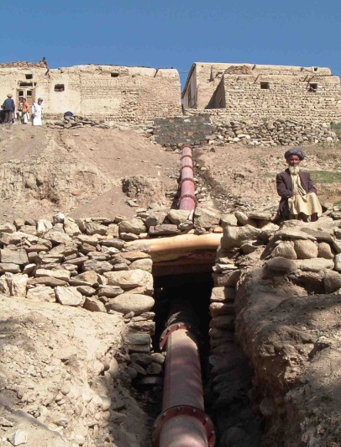
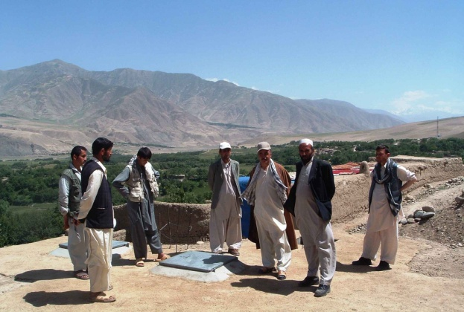
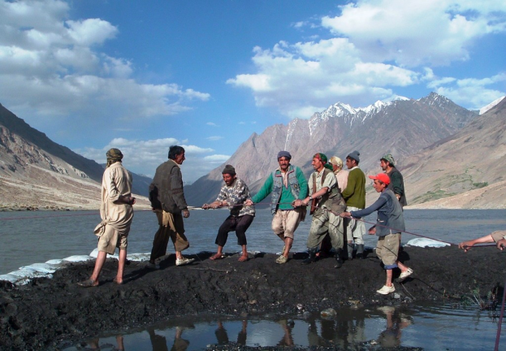
COIN: National Solidarity Program
Unclassified
34
Afghanistan’s largest development program
Goal: “to develop the ability of Afghan communities to identify, plan, manage and monitor their own development projects”
Uses Community Development Councils (CDCs)
Projects to Date: 52,000
Notes:
34

Slide 35
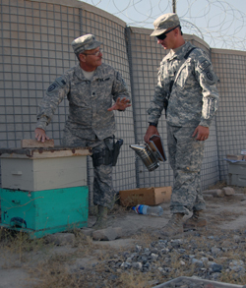
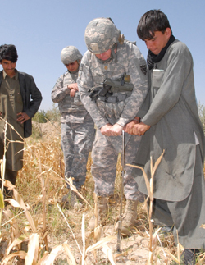
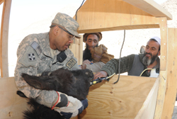
COIN: Agricultural Development Teams
UNCLASSIFIED
National Guard Initiative
Farmer-to-Farmer
“Reach back”
Projects
35
Notes:
35

Slide 36
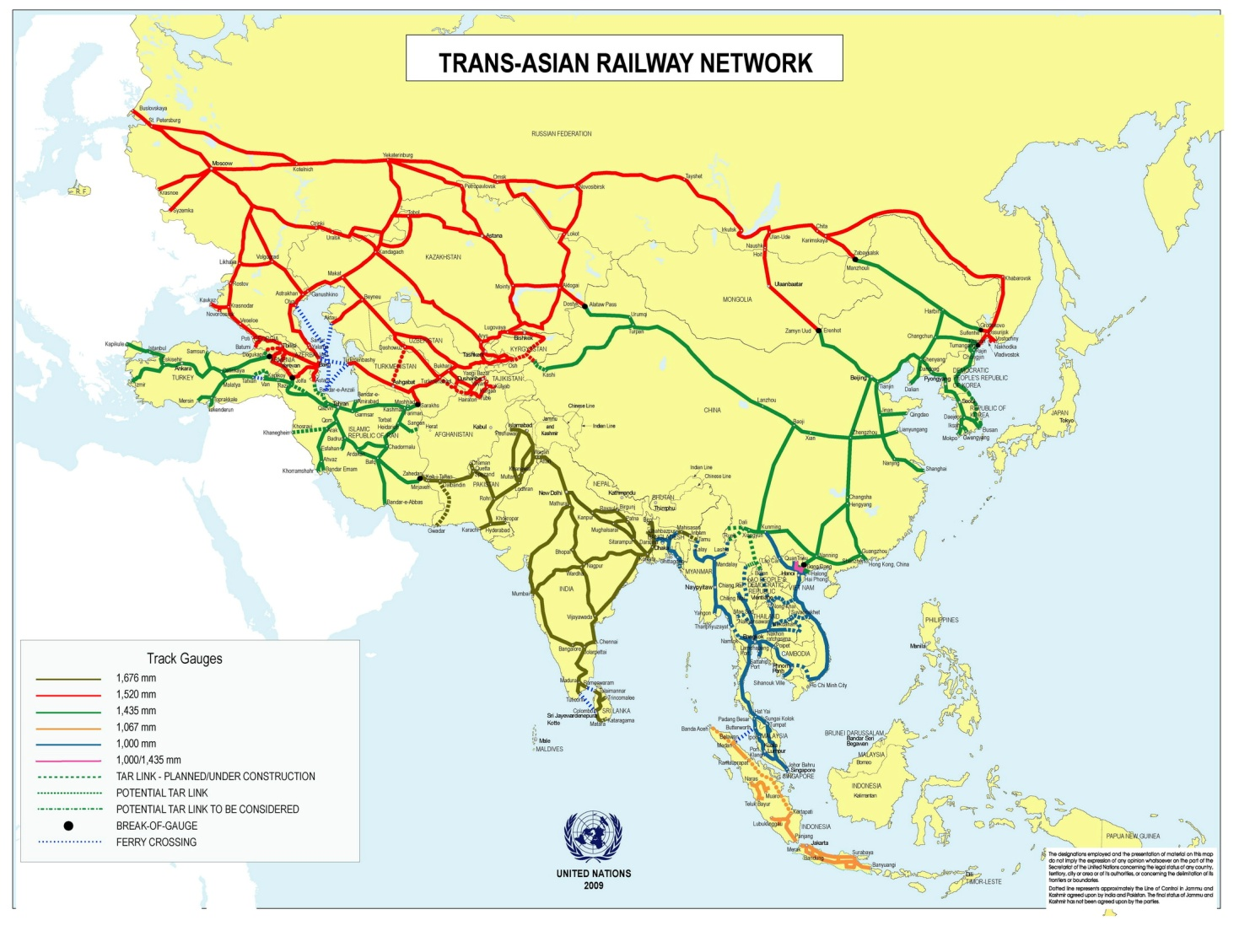
Infrastructure – Railroads
UNCLASSIFIED
36
Notes:
36

Slide 37
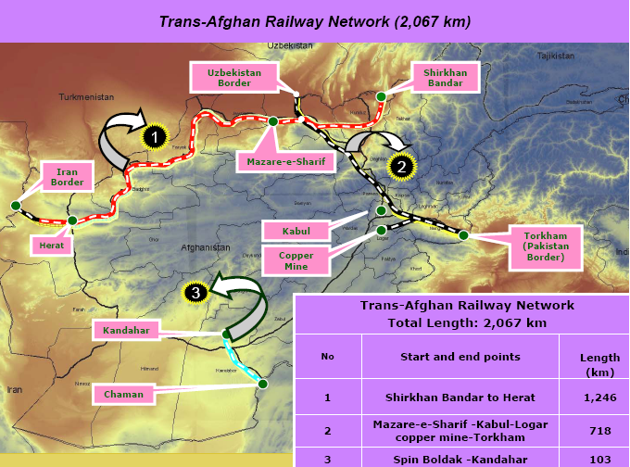
Trans-Afghan Railway Network
UNCLASSIFIED
37
Notes:
37

Slide 38
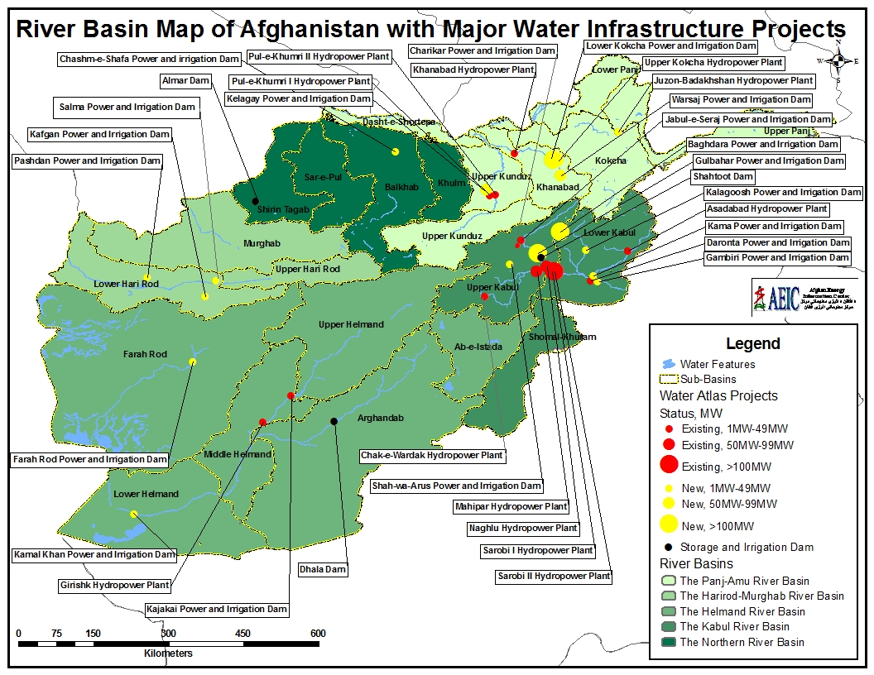
Infrastructure – Water
UNCLASSIFIED
38
Notes:
38

Slide 39
Infrastructure – Water
UNCLASSIFIED
39
Notes:
39

Slide 40
Inhibitors
UNCLASSIFIED
Lack of security
Heavy reliance on international partners
Corruption
Failure of development projects
Emphasis on capacity building
Weak financial sector
Illicit agriculture economy based on poppy cultivation
Notes:
40

Slide 41
Enablers
UNCLASSIFIED
National agriculture program
Procurement process that favors Afghan firms
Licensing frameworks for mineral development
Increased access to credit
Trade access to established markets
More robust transportation system
Support vocational training
“Made in Afghanistan” branding
Notes:
41

Slide 42
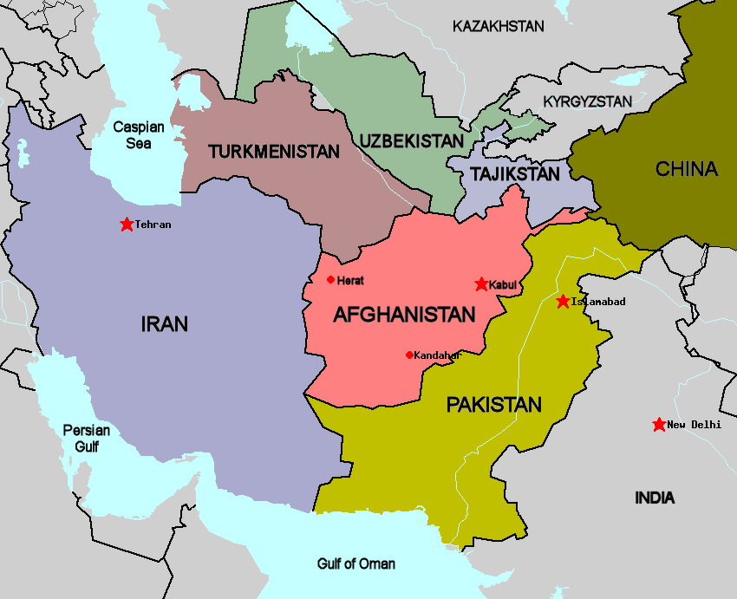
The Regional Economic View
UNCLASSIFIED
Gwader Port
$215M in trade
Mineral resources
Provides consumer goods
Transportation
Telecommunications
Chahbahar Port
Highway Herat-Dogharom
Power from Torba-e-Jan
Economic Colonialism
APTTA
Largest regional donor
Chahbahar Port
Zaranj-Delaran road project
Notes:
42

Slide 43
The Regional Economic View
UNCLASSIFIED
Gwader Port
$215M in trade
Mineral resources
Provides consumer goods
Transportation
Chahbahar Port
Highway Herat-Dogharom
Power from Torba-e-Jan
Economic Colonialism
APTTA
Largest regional donor
Chahbahar Port
Zaranj-Delaran road project
43
Notes:
43

Slide 44
The Regional Economic View
UNCLASSIFIED
Gwader Port
$215M in trade
Mineral resources
Provides consumer goods
Transportation
Chahbahar Port
Highway Herat-Dogharom
Power from Torba-e-Jan
Economic Colonialism
APTTA
Largest regional donor
Chahbahar Port
Zaranj-Delaran road project
44
Notes:
44

Slide 45
The Regional Economic View
UNCLASSIFIED
Gwader Port
$215M in trade
Mineral resources
Provides consumer goods
Transportation
Chahbahar Port
Highway Herat-Dogharom
Power from Torba-e-Jan
Economic Colonialism
APTTA
Largest regional donor
Chahbahar Port
Zaranj-Delaran road project
45
Notes:
45

Slide 46
The Regional Economic View
UNCLASSIFIED
Gwader Port
$215M in trade
Mineral resources
Provides consumer goods
Transportation
Chahbahar Port
Highway Herat-Dogharom
Power from Torba-e-Jan
Economic Colonialism
APTTA
Largest regional donor
Chahbahar Port
Zaranj-Delaran road project
46
Notes:
46

Slide 47
The Regional Economic View
UNCLASSIFIED
Gwader Port
$215M in trade
Mineral resources
Provides consumer goods
Transportation
Chahbahar Port
Highway Herat-Dogharom
Power from Torba-e-Jan
Economic Colonialism
APTTA
Largest regional donor
Chahbahar Port
Zaranj-Delaran road project
47
Notes:
47

Slide 48
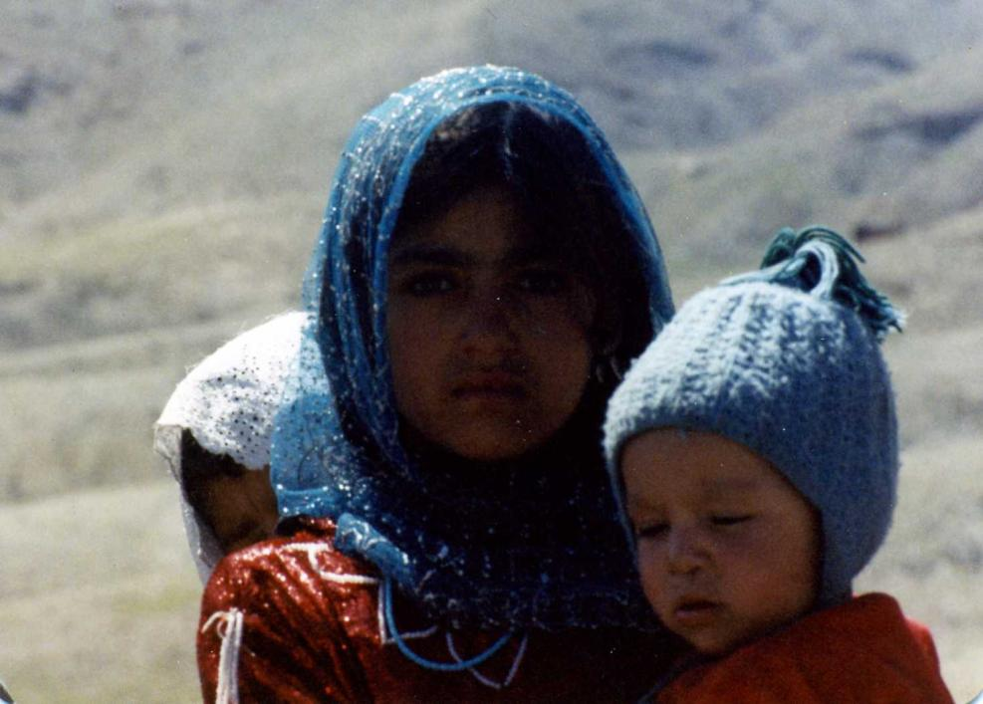
What constitutes social development?
48
Notes:
48

Slide 49


Social Development within the Afghan Context
Government institutions and a society that educates its young, offers medical services to all, facilitates sustainable livelihoods and ensures peace in a manner consistent with Islam.

Slide 50


Afghan National Development Strategy
50
Notes:
50

Slide 51


Education Today in Afghanistan
Traditional vs. Conventional
Community-based Village Schools
Technical/Vocational
51
Notes:
51

Slide 52


Islamic Education in Afghanistan
What is Islamic education?
How is it delivered?
Ministry of Education
52
Notes:
52

Slide 53



Education for Girls: A Harrowing Choice?
Culturally undervalued
Insurgents actively target school buildings
Female students targeted
Teachers assassinated
Backlash from population
53
Notes:
53

Slide 54




Challenges to the Education Sector
Unclassified
Security
Transportation
Resources

Slide 55

Health Care Sector: A Good News Story
Unclassified

Slide 56

Basic Package of Health Services (BPHS)
Unclassified
Purpose
Expand access for services that address priority health problems
Improve health indicators for women and children
Ministry of Public Health
Partnership: MoPH and NGOs
Single primary health care delivery mechanism
BPHS is the “road map”

Slide 57
BPHS Interventions
Unclassified
Maternal and newborn health
Child health and immunization
Public nutrition
Communicable disease treatment and control
Mental health services
Disability services
Regular supply of essential drugs

Slide 58
BPHS Accomplishments 2002 – 2008
Unclassified
Health Indicators
Under five mortality decreased 26%
Infant mortality decreased 22%
Maternal mortality declined (no statistics available)
Child immunization rates improved from 12% to 33%
Functional Indicators
Standardized health facilities
Population access increased from 10% to 80%
Facilities with female health care workers rose to 74%
Model for other countries

Slide 59

Challenges to the Health Care Sector
Unclassified
Lack of infrastructure
Security
Access to health care facilities
Lack of trained health care workers, especially women
Continued funding

Slide 60


Refugees and Internally Displaced Persons (IDPs)
UNCLASSIFIED
Difference between a refugee and an IDP
Stress on already overburdened systems
Historic recruiting base for insurgency
Challenges of repatriation/return
Fewer services
Loss of land/property
Status issues
60
Notes:
60

Slide 61
The important questions for policy-makers:
How to disrupt, dismantle, and defeat Al-Qaeda and ensure Afghanistan will not return to a safe-haven for terrorists;
How to stabilize and achieve a successful Transition by end of 2014
How to enable Afghanistan for the “Decade of Transformation” 2014-2024

Slide 62

Economic growth has been strong…
Average GDP growth over FY 2003/04–11/12 was 11.6% (10.2% without “outlier” years)
Notes:
Note: These numbers are excluding opium! Opium makes about 16% of GDP in 2010/11. Growth is included in agriculture, and has been more pronounced in the early years of 2000’s.

Slide 63

Contributors of GDP 1389 (2010-2011)
U.S. Dollars, Billions
8.2% GDP Growth (2010/11)

Slide 64


Drivers of Economic Growth
Private investment (8.5% of GDP) and exports (2.5% of GDP) have been low; GDP growth has been mainly driven by consumption
GDP growth is very sensitive to agriculture developments
In the future, mining is expected to be a major contributor to growth
Overall GDP and Agriculture GDP
Composition of GDP
Notes:
Note: These numbers are excluding opium! Opium makes about 16% of GDP in 2010/11. Growth is included in agriculture, and has been more pronounced in the early years of 2000’s.

Slide 65
Afghanistan: Government Revenue Excluding grants

Slide 66
Afghanistan: 35.3 Mil.
World Bank, World Development Indicators, 2012

Slide 67
1392 (2012/13) overall budget composition
Total budget ($ 6.809 Billion)
Development Budget ($ 3.033 Billion)
Operating Budget ( $ 3.775 Billion)
Total revenue ( $ 6.5 Billion)
Domestic resources ($ 2.488 Billion)
External resources ( $ 4.076 Billion)
Budget deficit( $ 244.18 Million)
1392 development budget increase by 36%
1292 operating budget increased by 47 %

Slide 68
1392 (2012/13) Budget funding sources
Operating budget ($3775 m)
Development budget ($3033 m)
Notes:
The Government is still heavily reliant upon donor financing, for operating but especially for development budget.

Slide 69
Operating budget comparison

Slide 70
1392 operating budget by sector

Slide 71
1392 development budget by sector

Slide 72

Fiscal sustainability projections (operating budget only)
Based on Tokyo Conference $16Bn Donor Commitments
Notes:
Source MTFF

Slide 73

At Present Afghanistan is Fiscally Unsustainable
Military Spending
$112 billion
External Budget
$16.2 Bn
Over 92% of total public spending in 2010/11 financed by aid
2010/11 aid ($15.7 bn) exceeded nominal GDP ($15.4 bn)
Total Aid to Afghanistan was 93-97% of GDP
Private Sector Investment was only 3.2% of GDP
Core Budget
$4.6 Bn
GIRoA Revenues $1.85 Bn
2010/2011 Afghan Government Inflows
Ministry of Finance/WB
A sudden decline of military and donor aid will lead to a significant economic contraction especially on the local economies;
Notes:
So what happens as we approach 2014?
Lets start by looking at the numbers.
In 2010/2011the Afghan domestic revenue collection reached US$ 1.65 bn (doubled since 2007/08) as a result of significant effort by MoF.
Core Budget (domestic revenue + on-budget donor aid) US$4.6 bn
External Budget (Donor-financed off-budget expenditures) MoF reports $6 bn but actual amount may be as high as US$16 bn
International military spending (We can estimate the US portion which is approximately $100 billion but have no visibility on our allies expenditures. In the final alalysis this estimate could be as large as 100 times greater than domestic revenue). The good news is most of this is spent outside Afghanistan. But even if the funds that reach Afghanistan are a small slice of this very large total the could have a big effect on domestic growth.

Slide 74

Import / Export Trade Flows in Afghanistan
U.S. Dollars, Billions
More than 80% of Export increase since 2001 is Fresh Fruits
IMF, Direction of Trade Statistics, 2012; Note: The 1993 data point for exports was removed due to data irregularities
Notes:
Only increase of $313 million in exports from 2000 to 2011

Slide 75


Slide 76


Afghanistan National Development Strategy (ANDS)
Survey Conduct in 2006 Covered All 36 Provinces
Most Extensive Consultation Process in history of Afghanistan with more than 36,000 participants
Consultation ranged from village level to major urban cities

Slide 77
Key Lessons: Economic Development
UNCLASSIFIED
Although a poor country, Afghanistan has resources that can be leveraged to build a stable economy
Afghanistan needs a regional solution to achieve successful economic development
Successful COIN requires a stable economy and economic opportunity for Afghans
Notes:
77

Slide 78
Key Lessons: Social Development
UNCLASSIFIED
The education sector suffers from a widespread lack of capacity and resources with Islamic education offering an alternative
The health care sector is a “good news” story, especially the Basic Package of Health Services program, but rural health services remain lacking
Refugees and IDPs remain a concern in terms of humanitarian aide as well as a potential recruiting ground for the insurgency
78
Notes:
78

Slide 79
Problem Statement
With a 35-40% unemployment rate, Afghanistan faces a crisis in generating employment opportunities and reducing the pool of young men vulnerable to extremism;
Procedural and infrastructural deficiencies limit trade between Afghanistan and its neighbors;
Afghan citizens view the state of the economy as a more serious problem than security by a margin of two to one.
Consequently:
Current economic development efforts are failing to reinforce the United States broad strategic goal in Afghanistan to “disrupt, dismantle, and defeat Al-Qaeda”.
To Support a Successful Transition an integrated Economic Strategy is required to Stabilize at Village Level and generate the necessary jobs and revenue at National Level.

Slide 80

How does the scale-down of aid affect growth and stability?
GDP growth projections 2011–25: Aid scenarios
Major Economic Issues
Falling Aggregate Demand
Weak Infrastructure & Poor Market Access
Bottlenecks at Border Crossings
Weak Afghan Private Sector
Low Foreign Direct Investment (FDI)
Poor Economic Governance & Institutions

Slide 81
Who will feel the economic impact of the transition process?
Significant Impact in larger in conflict provinces and urban centers because they received most of the aid
Declining aid is likely to aggravate underemployment more than unemployment.
Estimates suggest that a $0.5 billion decline in the external budget could affect up to 20,000 jobs
Immediate impact will be felt by low-skilled workers in construction, transportation and retail selling to military and aid community
Will also impact higher skilled technical professionals who directly work on aid projects and Government institutions.
Effects of Economic Problems
Demand for Afghan Goods and Services is Falling
Private Sector Leaving
Rising Unemployment
From Hope and Opportunity to Anger and Fear
Brain Drain
Capital Flight
Rising Demand for Violence
Breeding Ground for Insurgency
Moving towards Illegal Economy and Criminal Activities

Slide 82
Alternative Futures
Scenario One - Failed Economic Transition
Significant Reduction in Economic Assistance
Severe Economic Contraction and Rising Unemployment
Increasing Risk of Internal Conflict
Scenario Two – Status Quo: Aid Dependency Continues
No Progress from Aid to Trade
Donor Fatigue and Unsustainability
Essential Economic Projects Abandoned
Scenario Three – Sustainability: Expedite New Silk Road
Regional Economic Integration
International Community Emphasizes Transition from Aid to Trade
Attract Private Investment to Boost Production and Scale-Up Exports

Slide 83
The New Silk Road Initiative
Aim: To support the design, implementation, and monitoring of a regional economic integration strategy to foster a transition to stability and greater economic cooperation between Afghanistan and its neighbors.
Vision: To establish Afghanistan as an efficient trade and transit hub connecting China with Europe and Russia with Pakistan and India, including for the exchange of energy and minerals.
Policy Goals:
To foster conditions for stability in Afghanistan through immediate investments in transport and energy infrastructure projects that spur job creation during the next 12-18 months.
To overcome the barriers to regional trade and transit in order to expand economic growth, employment, and public revenue.
To give regional states a larger stake in Afghanistan’s future and to better leverage their and other international resources.

Slide 84
The New Silk Road Initiative (NSRI):
A Regional Approach to Afghanistan Near and Long-term Sustainability and Stability
Historic trade routes hold potential to revitalize Afghanistan and the Region
Ideally situated geographically to connect Europe, Mideast & Asia
Trade & transportation services generate economic growth & stability
Transport & energy infrastructure projects can create jobs in the near-term.
Focus on Afghanistan: goals include improved stability and economic integration within its region, which should leverage regional capabilities
Concurrently assist regional transportation/energy infrastructure & trade and commerce facilitation (customs, tariffs, border procedures)
Northern Distribution Network (NDN) lesson: economically viable regional trade & transit networks CAN be enhanced in Central & South Asia (CASA)
Not a New Strategy Many countries, international financial institutions, and private sector enterprises are already spending billions to construct Modern Silk Roads running from Hamburg to Hanoi, Mumbai to Morocco. But this enormous effort is blocked at key borders and especially within Afghanistan. Until these impediments are removed, Afghanistan will remain the “cork in the bottle,” a barrier to continental transport via roads, railroads, oil and gas pipelines, and electrical transmission lines rather than its most important hub.

Slide 85

Ancient Silk Road

Slide 86

Northern Distribution Network
The Northern Distribution Network has demonstrated proof of principle for the viability of transcontinental trade
-Center for Strategic & International Studies, Sep. 2009
UNCLASSIFIED

Slide 87

Afghanistan as a hub for Intercontinental Trade

Slide 88

CAREC—A Silk Route to Markets
A New Silk Road to Markets
East Asia ⬄ EU
1995 = $244 billion
2008 = $795 billion
East Asia ⬄ Middle East
1995 = $57 billion
2008 = $454 billion
EU ⬄ South Asia
1995 = $34 billion
2008 =$117 billion
Notes:
Eurasia was at the heart of original Silk Route. After years of inaction, today we see booming trade flows, in most cases growing 3-fold since 1995. These go from east to west and north to south.
But the opportunity cannot be tapped unless we sort out some the problems of today…
Less than 1% of all China/Eurasia trade goes through the CA region.
Overland routes are avoided because of bad roads and bad customs systems
Time spent at borders can be up to 10 hours, in some cases 50% of total actual transit time
Several countries have energy resources, but are not exporting them
Improving infrastructure connectivity, therefore, is essential for further development of the region.

Slide 89

Afghanistan National Development Strategy (ANDS)
“Afghanistan’s history is testimony to its special position on the ancient Silk Road that for centuries connected Europe and Asia and helped move people, goods and ideas across continents. Afghanistan, therefore, has great geopolitical importance and immense economic significance due to its strategic location as the land bridge between the sub-continent, Central Asia and the Persian Gulf and has natural propensity to serve as a bridge in facilitating commerce and energy flows across energy rich Central Asian region to energy deficit South Asian countries and much needed access to transportation corridors from inner Asia to the Indian Ocean. Its geo-strategic location could be leveraged to promote regional economic cooperation and integration across the surrounding regions. It will open new opportunities for Afghanistan’s economic development and will propel economic growth, development and systematic poverty reduction in the wider region. This in turn will bring greater stability to the country, improve the business climate and provide growing opportunities for the business sector.”
"Afghanistan is reemerging as the ‘Asian Roundabout,’ a central point of interconnection of goods, ideas, services and people in the fast expanding Asian economy. Our location in the centre of the new Silk Road makes us a convergence point of regional and global economic interest.”
President Karzai, July 20, 2010

Slide 90
Who is supporting the New Silk Road Initiative
Secretary Clinton: Chennai – July 20, 2011 “Let’s work together to create a new Silk Road. Not a single thoroughfare … but an international web and network of economic and transit connections. … That means building more rail lines, highways, energy infrastructure. It means upgrading the facilities at border crossings…And it certainly means removing the bureaucratic and other impediments to the free flow of goods and people.”
President Karzai: Kabul – September 15, 2011 “the Silk Road is the historical trading routes of our region. This is something we all know very well and we can all agree on. The Silk Road is not a dream but is already being built.” (translated from Dari)
New Silk Road Foreign Minister Meeting at the United Nations General Assembly: New York – September 22, 2011 “The international community is committed to a secure, stable, and prosperous Afghanistan, integrated in a secure, stable, and prosperous region. The New Silk Road vision is part of making that objective a reality for the people of South and Central Asia by advancing a comprehensive economic strategy centered around Afghanistan.”
Regional Istanbul Conference for Afghanistan: Istanbul – November 2, 2011 “We recognize Afghanistan’s role as the land bridge in the ‘Heart of Asia’, the Silk Road will connect South Asia, Central Asia, Eurasia and the Middle East, and reaffirm our support in the strongest possible terms to the secure, stable and peaceful future of Afghanistan.”
GEN John Allen: Kabul – January 2012 “the New Silk Road will directly and substantially improve the lives of the people of Afghanistan and the region, reinforce our current military posture with a viable economic strategy, provide the Afghan government with a self-sustaining revenue stream, and integrate the region into the broader Eurasian landmass.”

Slide 91

Who is supporting the New Silk Road
Ambassador Marc Grossman Special Representative for Afghanistan and Pakistan
Washington – June 8, 2011
“I visited CENTCOM early after my appointment as the Special Representative for Afghanistan and Pakistan. There were many impressive things about the day, but what stuck with me was the idea of a New Silk Road. Why?
The New Silk Road is something positive to talk about in a region where positives can be hard to come by.
It connects our policy to an Afghan vision of an “Asian roundabout.”
It supports our policy of regional economic cooperation.
It supports the struggle against extremism by promoting and providing economic opportunity.
It supports our overall counterinsurgency strategy.
The New Silk Road brings in private sector possibilities and foreign direct investment. It leverages what official development assistance can do with the spirit of entrepreneurship and opens opportunities for U.S. firms.
The New Silk Road connects Afghanistan and Pakistan, Pakistan and India, Afghanistan and India, and South Asia with Central Asia.”

Slide 92
New Silk Road From Region to Village:
An Integrated Approach
From Aid to Trade
Identify regional trade barriers
Dialogue with regional governments
Regional Mapping & Gapping Exercise
New Silk Road Region
Afghanistan Regional
Afghanistan Domestic
Village
Strategic Level: Policy
Identify bi-lateral trade barriers
Lack of Trade and Transit Agreements (or lack of implementation)
Lack of Water Treaties
Harmonization of Cross-Border Procedures
Lack of transport and energy Infrastructure
Lack of donor support for major infrastructure projects
Lack of Public Private Partnerships
Tactical Level:
Quick impact projects are unsustainable; do not provide long term stability
Need to develop sustainable village stability projects to support the Transition
Implementation
UNCLASSIFIED

Slide 93
Opportunities
New transit routes: North-South (Moscow – Dehli); East-West (Beijing – Istanbul, Persian Gulf)
Better access to export markets for a landlocked region (some countries double-landlocked)
Regional and local (cross-border) trade potential
Infrastructure in Afghanistan is progressively being rebuilt (especially main roads)
Significant Central Asian energy resources, with export potential and complementary endowments within region (hydro + thermal)
Regional cooperation seen as supporting peace, stability, and sustained development (so the benefits are not just economics-related)

Slide 94

Continental road and railroad corridors focusing on Afghanistan

Slide 95
New Silk Road in Strategic Interest of US
The NSRI will support a Successful Transition through 2014
The NSRI has the potential to reduce the capability of the insurgency to harm the Afghan government and its allies, with an emphasis on stabilization and job creation.
It can establish Afghanistan and its region as a viable land-transport bridge between Europe and Asia to foster stability and economic integration.
It will transform US & NATO/ISAF engagement in Afghanistan and the region from military to economic. Transition Afghanistan from War & Aid to Stability & Trade
It will foster burden-sharing with international partners and the return on investment (ROI) would amount to only a fraction of USG investment.
In short, the New Silk Road Initiative can reinforce the United States’ broad strategic goal in Afghanistan to “disrupt, dismantle, and defeat Al-Qaeda”, by engaging Central and South Asian States and the wider international community more actively in forging an international and regional strategy to stabilize Afghanistan.
Economic progress will create the conditions that will enable the U.S. to shift its main emphasis from military power to economic development

Slide 96
Role of the United States
Unique capacity of the United States to solve the collective goods problem and simultaneously alleviate concerns that the U.S. is only interested in an exit strategy. This is not an exit strategy.
This strategy will help the United States in eliciting buy-in from Afghanistan and other regional partners for a strategy truly regional in scope
U.S. can only advance a New Silk Road Strategy by working within a regional partnership with Afghanistan and with its neighbors. This regional strategy depends on a framework that identifies common interests based on trade.

Slide 97
Cost of not engaging in New Silk Road
Short-lived gains in security
Reinforce the notion that overall U.S. presence in the region will end soon (abandoning Afghanistan)
Appear that U.S. interests are self-centered to accommodate their own limited objectives
Undercut the willingness of NATO and other international partners to join American-led missions in the future.

Slide 98
Conclusion
If access to jobs and decent incomes is not greatly expanded, poverty will continue as a breeding ground for insurgency and terrorism; the opium industry and criminal networks will continue to flourish to fuel the insurgency.
Competition for the minimal resources available will increase between ethnic groups and tribes fueling insecurity.
Unemployment especially among the youth will fuel insecurity in the cities.
Significant Economic Contraction will jeopardize the Transition
The New Silk Road gives the means to Afghanistan and International Community to preserve the gains of the last Decade.

Slide 99
We finally understand!
'When we understand that slide, we'll have won the war,' General Stanley McChrystal
=
JOBS

Slide 100

Questions?
Unclassified

Slide 101
Application and Practice of Processes
“so what”
Please take 5 minutes to identify the most important “so what”

